Slide 1
Social media app using cloud platform
Pravin

Slide 2
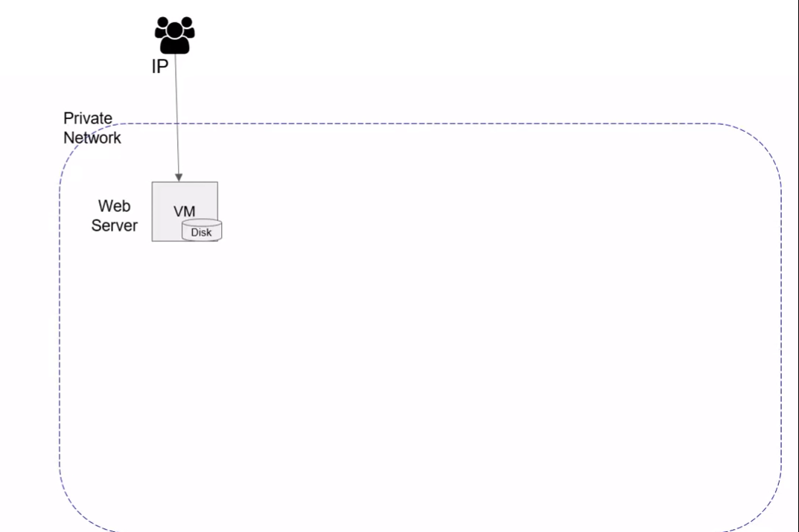
Xyz.com

Slide 3
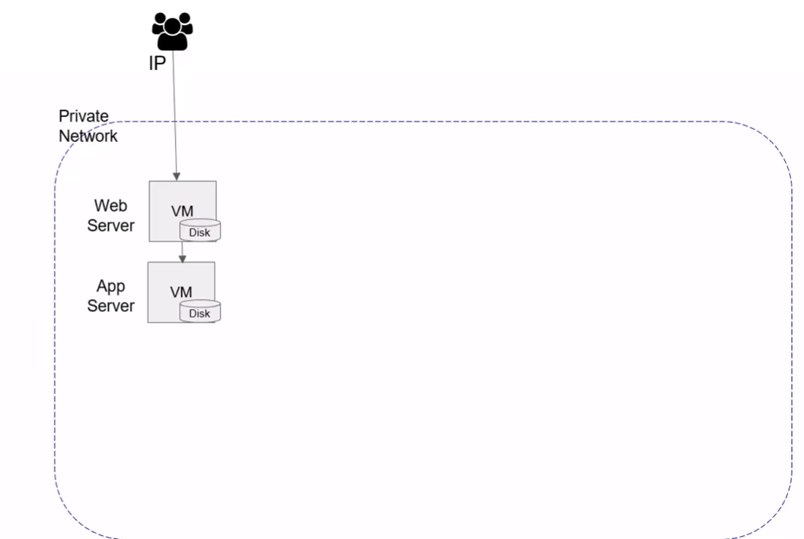
Xyz.com

Slide 4
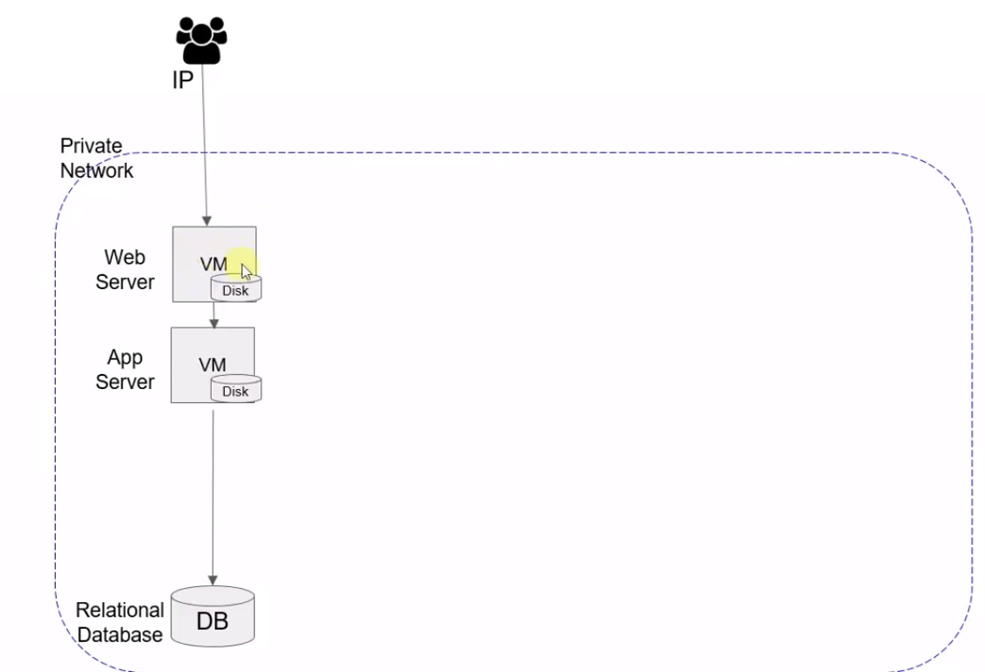
Xyz.com

Slide 5
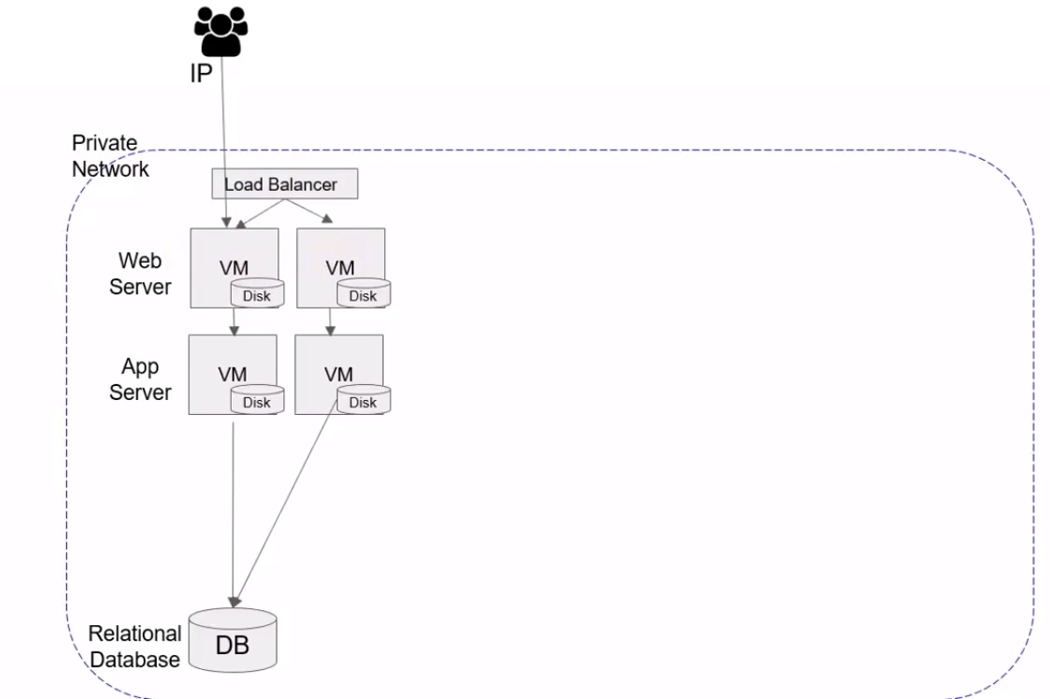
Xyz.com

Slide 6
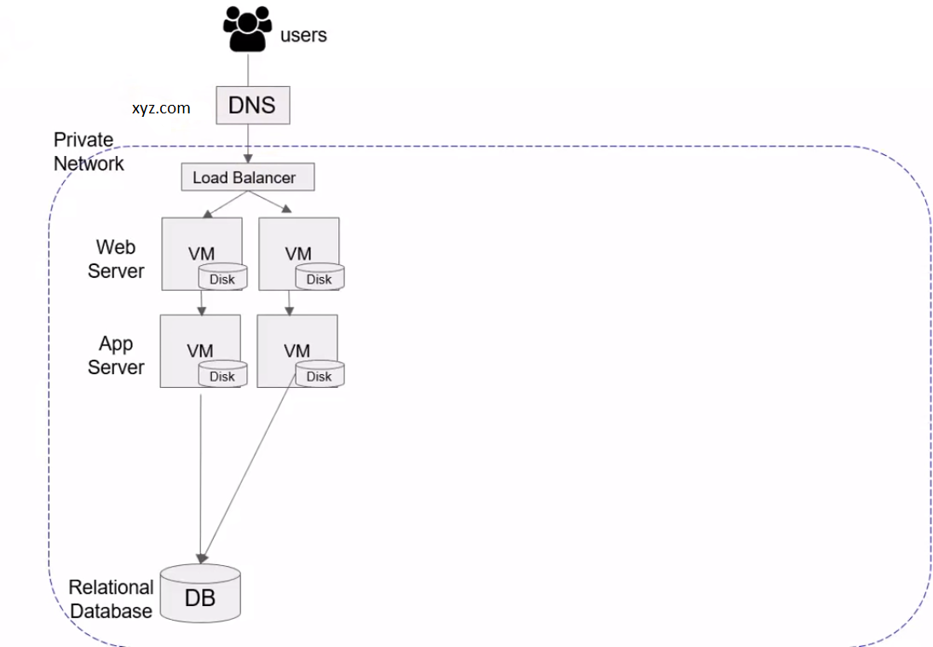
Xyz.com

Slide 7
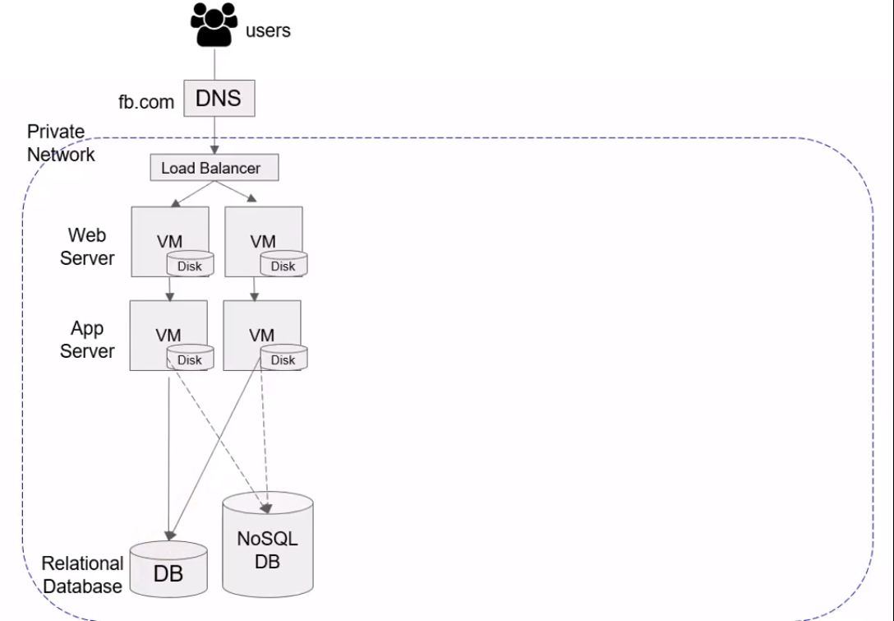
Xyz.com

Slide 8
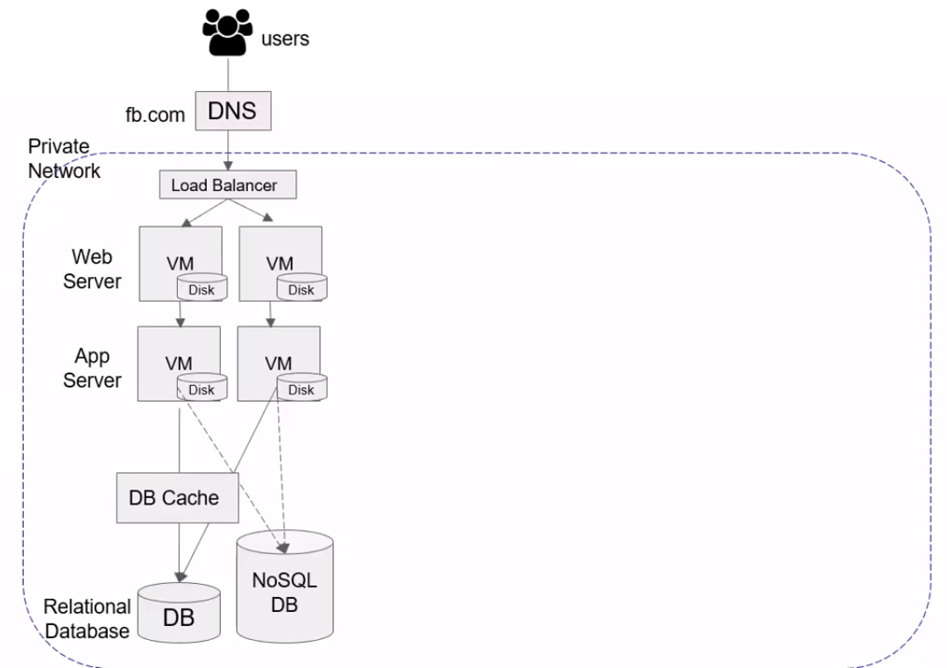
Xyz.com

Slide 9
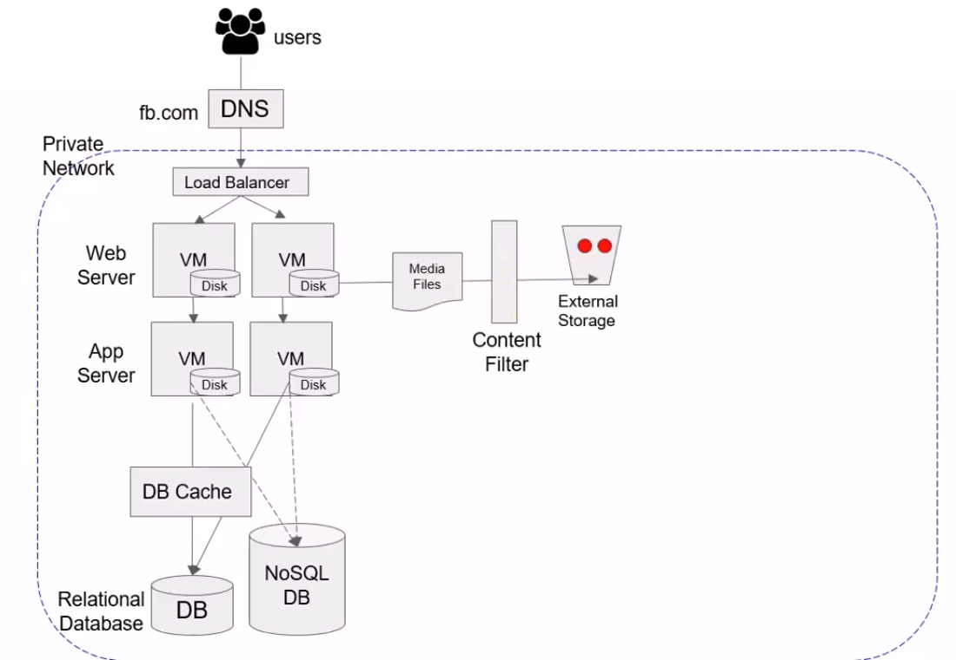
Xyz.com

Slide 10
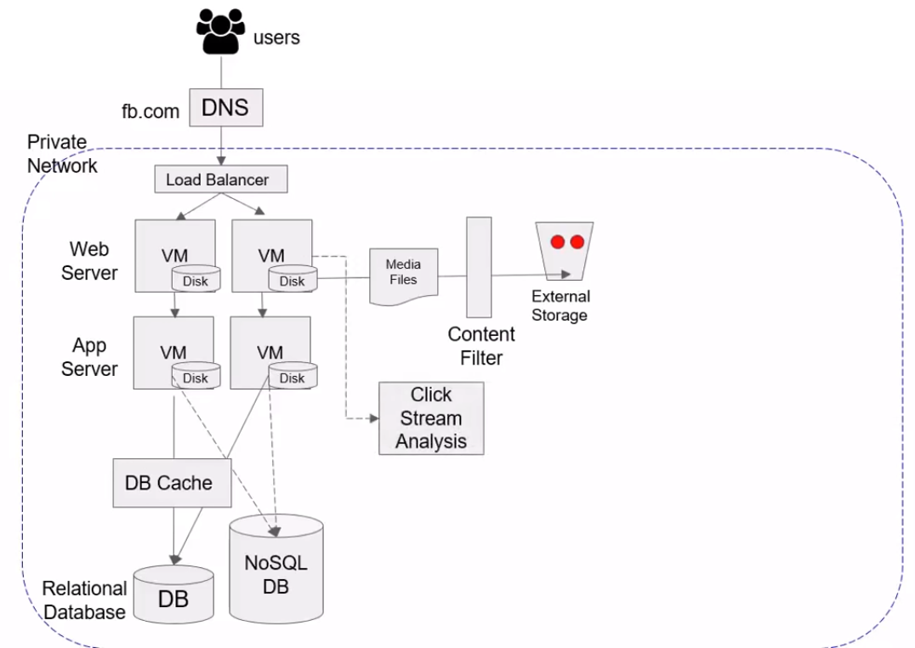
Xyz.com

Slide 11
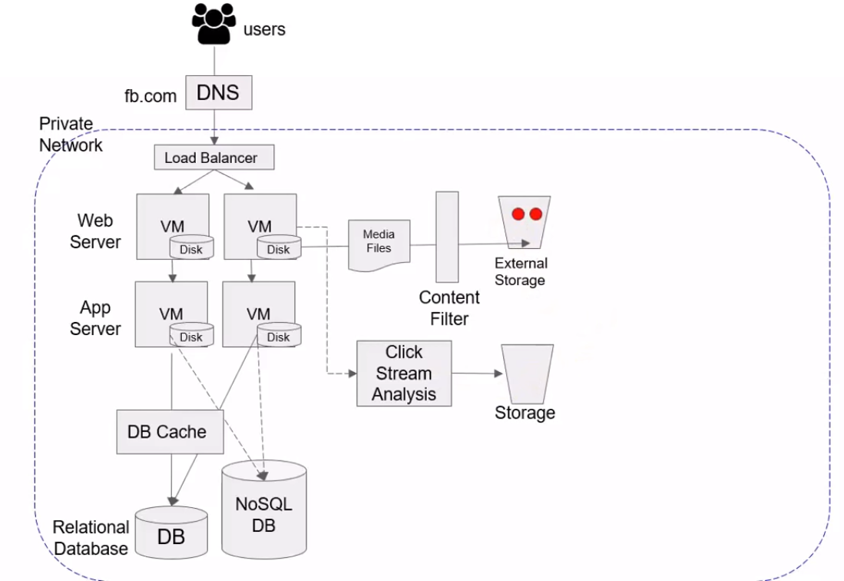
Xyz.com

Slide 12
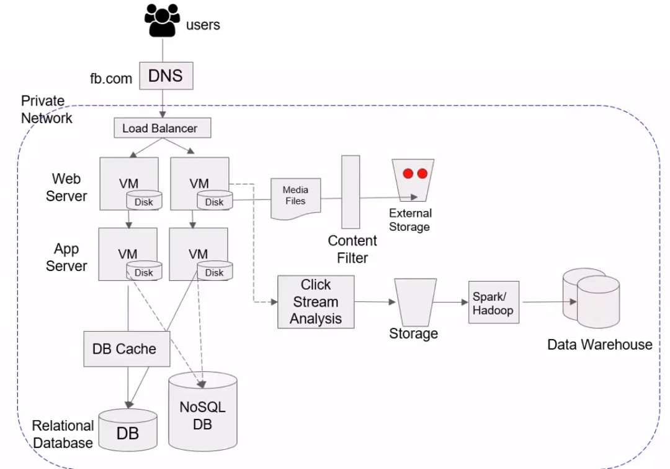
Xyz.com

Slide 13
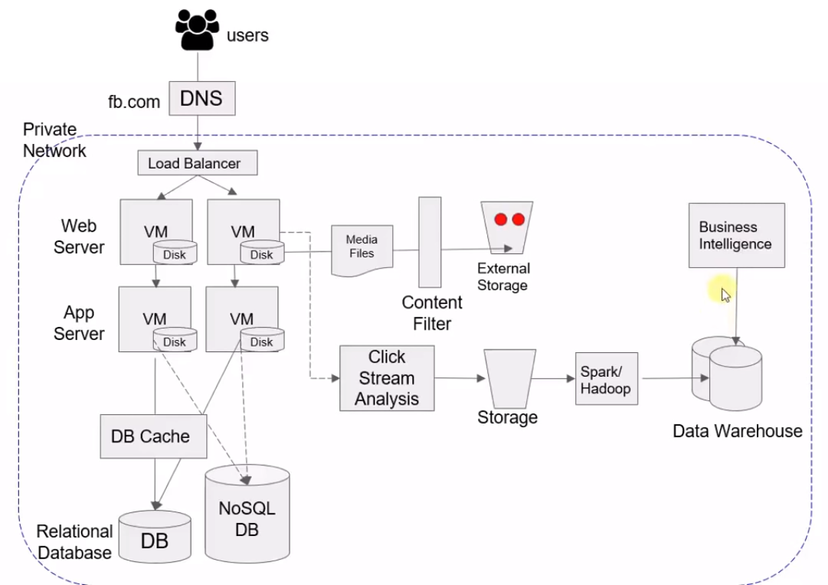
Xyz.com

Slide 14
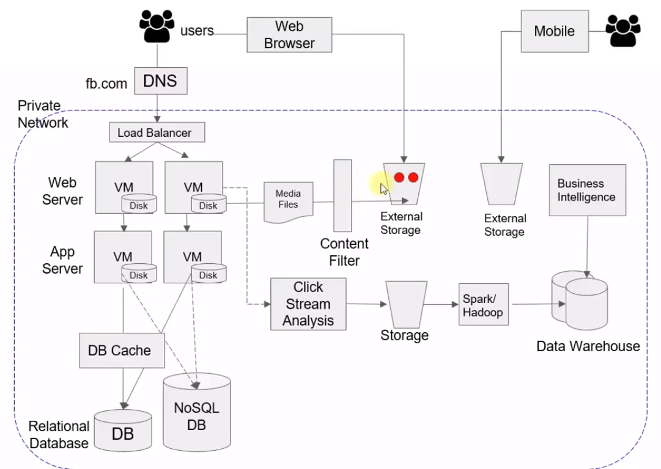
Xyz.com

Slide 15
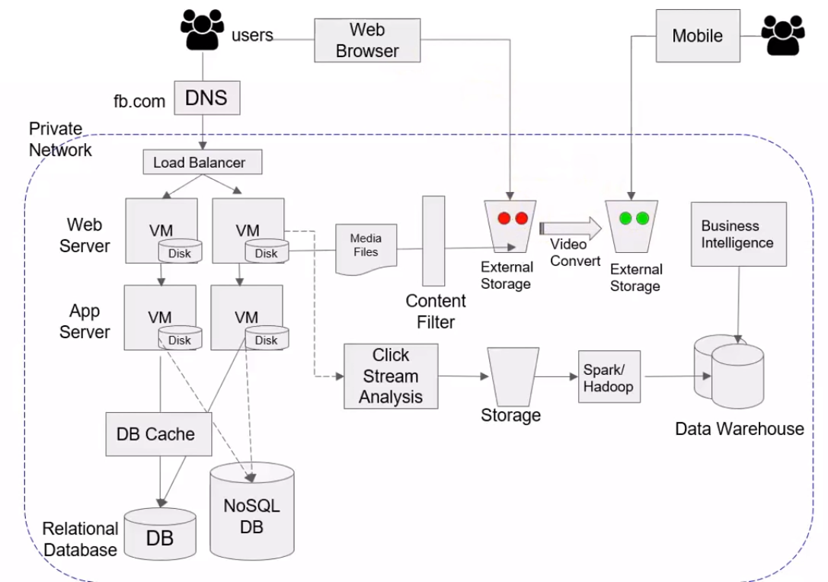
Xyz.com

Slide 16
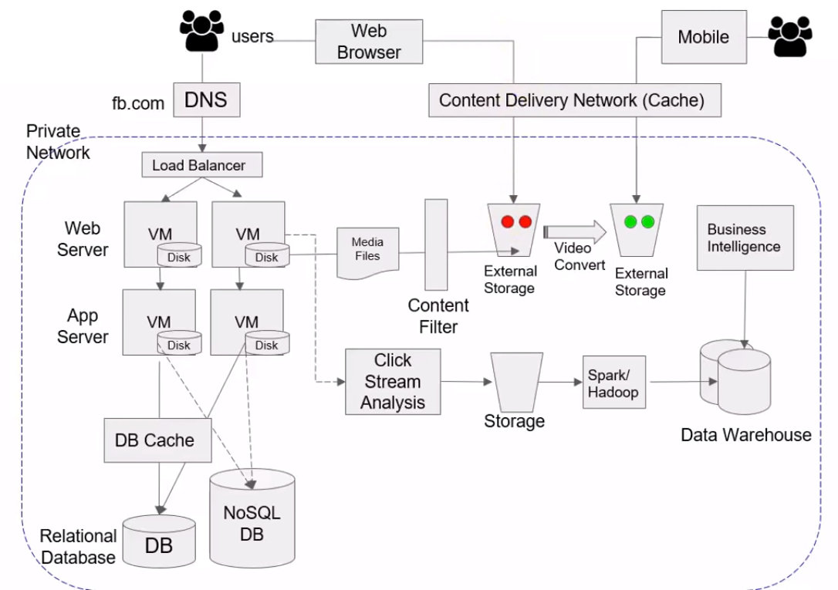
Xyz.com

Slide 17
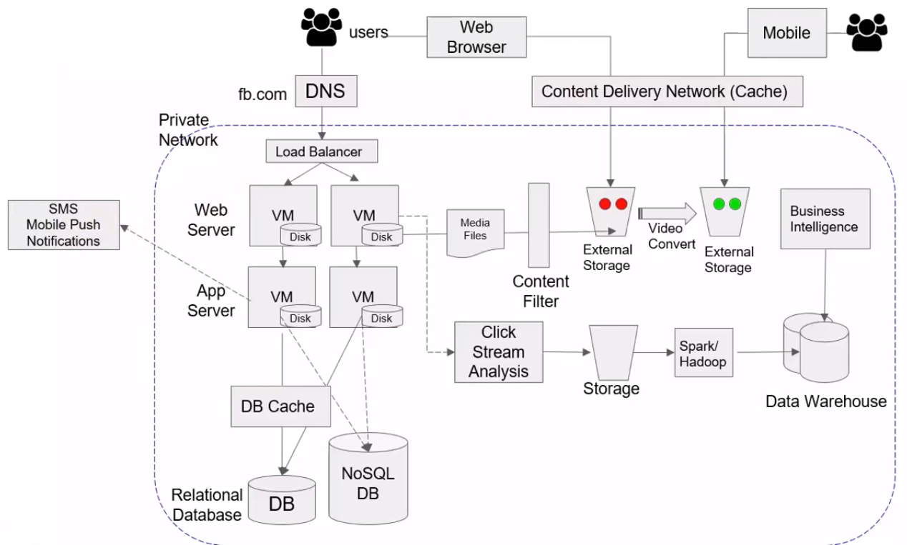
Xyz.com

Slide 18
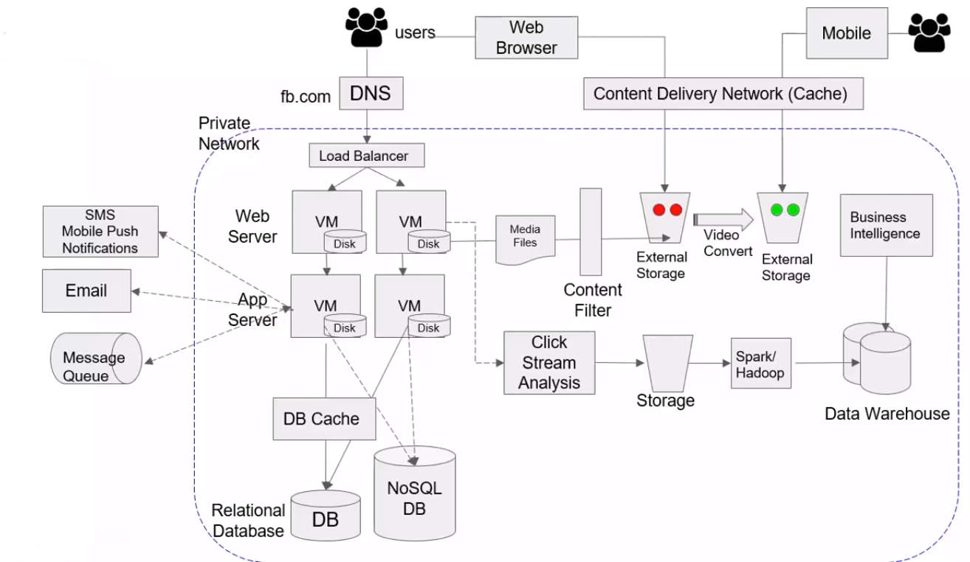
Xyz.com

Slide 19
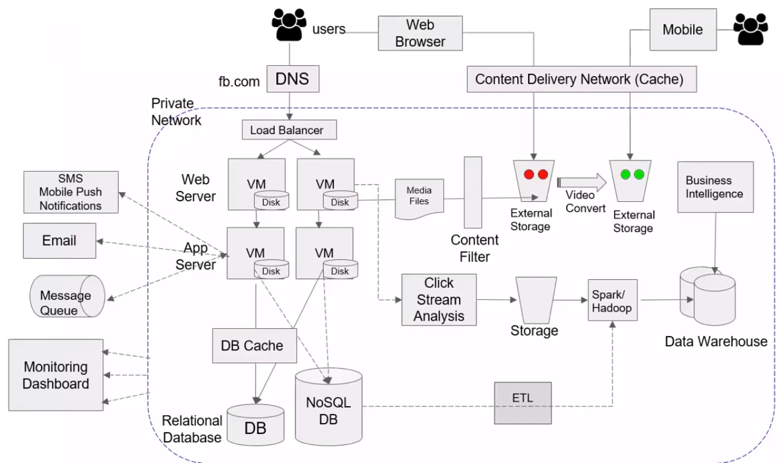
Xyz.com

Slide 20
Social Media App on Azure

Slide 21
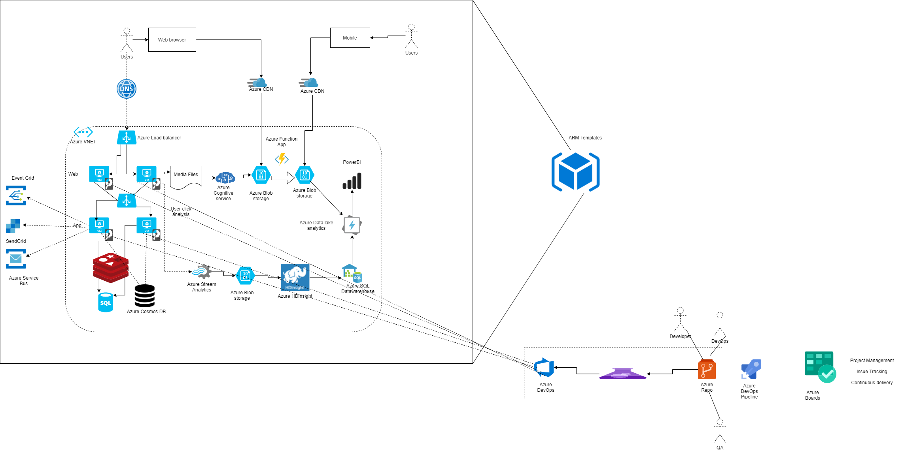
Social Media App on Azure with Azure DevOps (CI-CD)

Slide 22
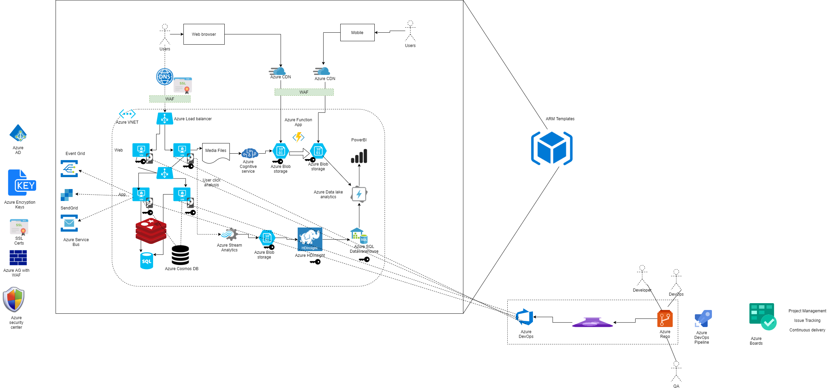
Security

